Slide 1




Beeclust Multi Robot Systems Lab
1306/A, Dept. of ECE, Tech Park

Slide 2
What we do?
Beeclust Multi Robot Systems Lab (Beeclust MRSL) started in February, 2017 is a research team working in the field of swarm robotics.
The team is associated with Dept. of ECE and funded by Directorate of Research, SRM-IST.
Our first project titled Sprinter has been patented.
Our research has been published in international conferences.
We have participated and won in various national and international competitions and hackathons.

Slide 3
Our Mentors
Faculty Coordinators:
Dr. R. Kumar, Professor, Department of ECE, SRM-IST
Dr. S. Dhanalakshmi, Associate Professor, Department of ECE, SRM-IST
International Relations:
Dr. Lorenzo Sabattini, Associate Professor, Department of Engineering Sciences and Methods, University of Modena and Reggio Emilia, Italy
Team Principal:
Mr. Kedar Karpe, Batch of 2019, Department of ECE, SRM-IST

Slide 4
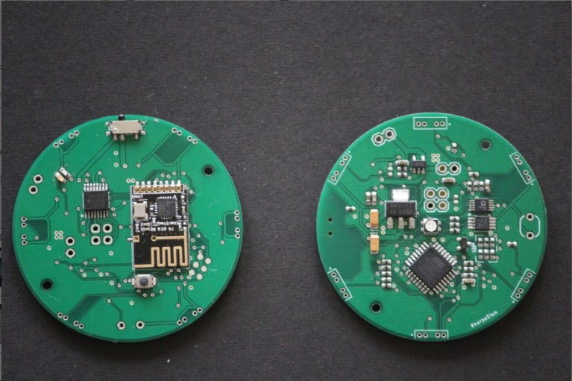
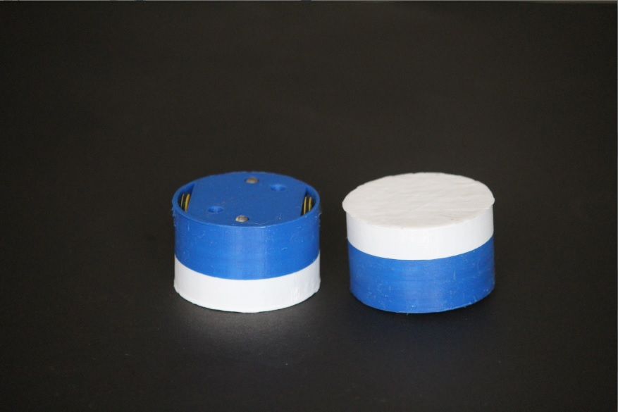
Our Domains
Embedded Systems:
Design the necessary electronic circuit boards.
Program the robots to perform the tasks we require.
Mechanical:
Design 3-D models of the robots and build all the physical blocks of the system.

Slide 5
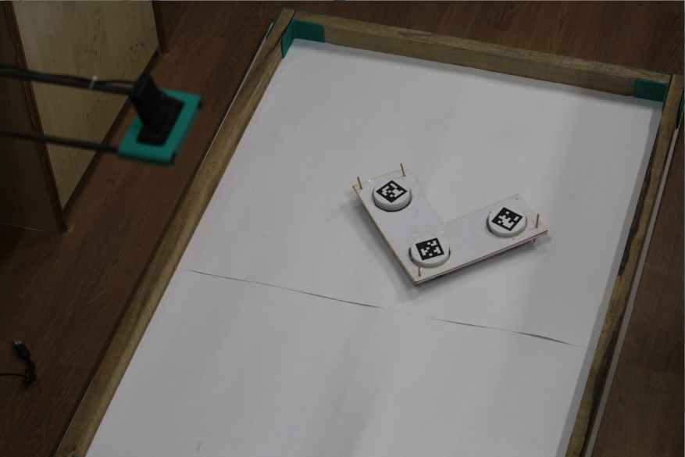
Our Domains
Robotics and Simulation:
Derive and test the algorithms by simulating them using software like MATLAB & Simulink.
Study the system by performing experiments through robots fabricated in our lab.
Computer Vision:
Interface Cameras with the system to track the robots in real time.
Provide feedback on any visible defects in the system.

Slide 6
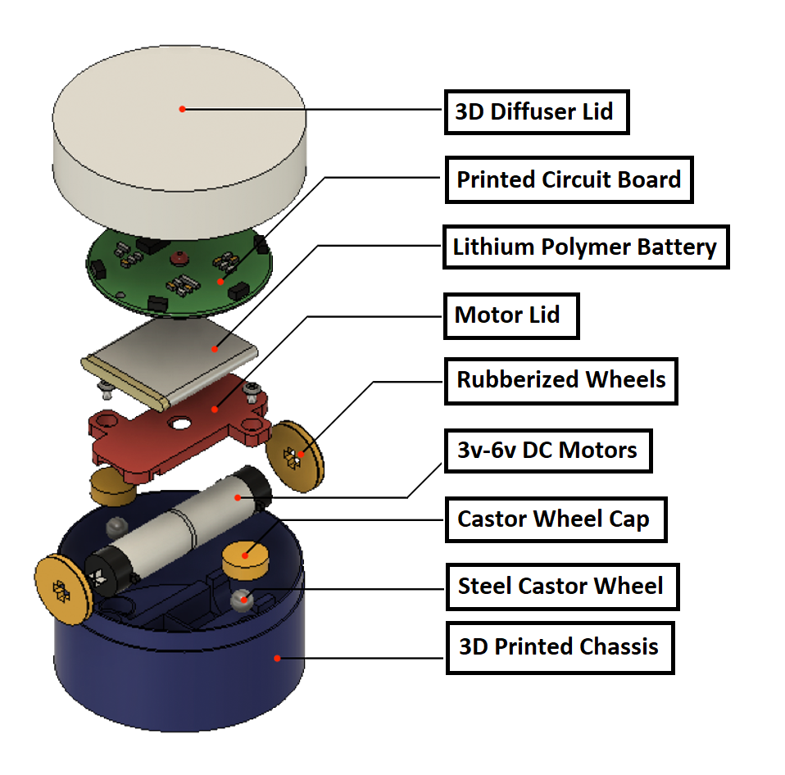
Current Projects
LOGISWARM: Logistics Using Semi-Automated Multi Robot Systems
OBJECTIVES:
To develop a Multi-Robot System for :
Simplifying warehouse transportation problems
Prevention of problems arising due to human intrusion
Making the current system more energy efficient
Reduction of cost and time

Slide 7
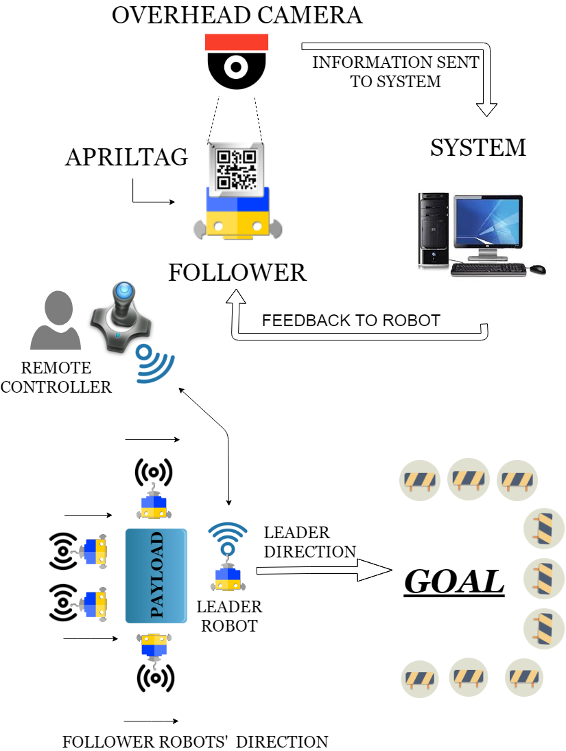
WORKING
WORKFLOW:
Deliverable 1 :
Development of tracking system for robots
Deliverable 2:
Design and Development of BudgeBOTs
Deliverable 3:
Coordinating the Multi-Robot System to work together
Deliverable 4:
Testing of the developed system in different scenarios

Slide 8
Outcomes
PATENT
A patent on multi robot testbed for research
CONFERENCES
International Conference on Intelligent Robots and Systems
International Conference on Robotics and Automation
International Conference on Robotics and Biomimetics
Project Funded By Directorate of Research, SRM-IST

Slide 9
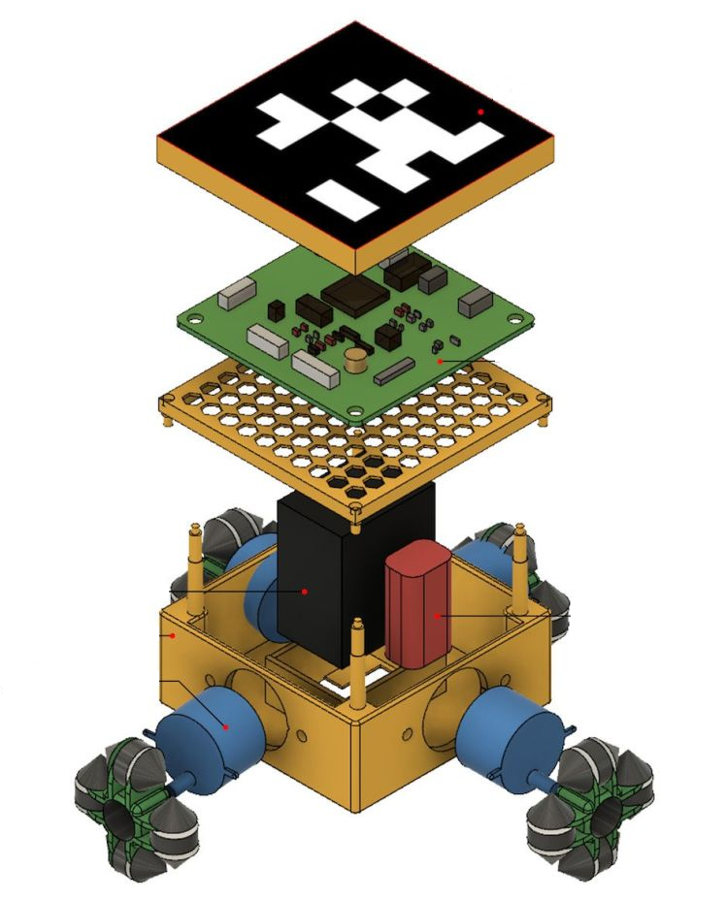
Projects Completed
Sprinter : A multi-robot printing system
A multi robot system capable of printing over a surface as they move.
The entire task of printing is divided among all the sprinters.
They communicate and coordinate themselves to complete the printing.
Printing can be done irrespective of the paper size.
Project was Funded By Directorate of Research, SRM-IST

Slide 10
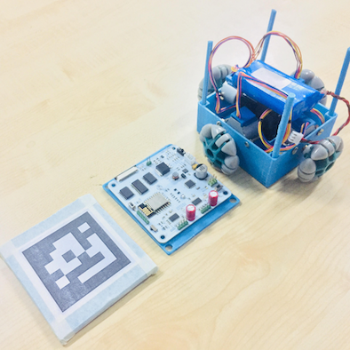
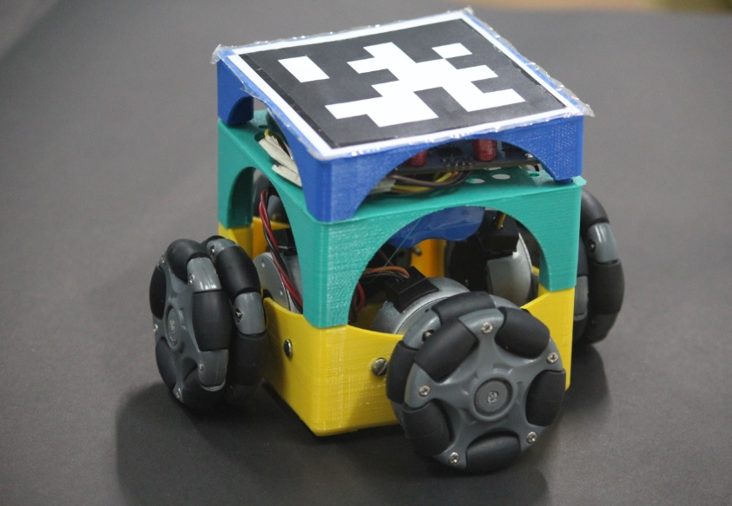
SPRINTER:

Slide 11
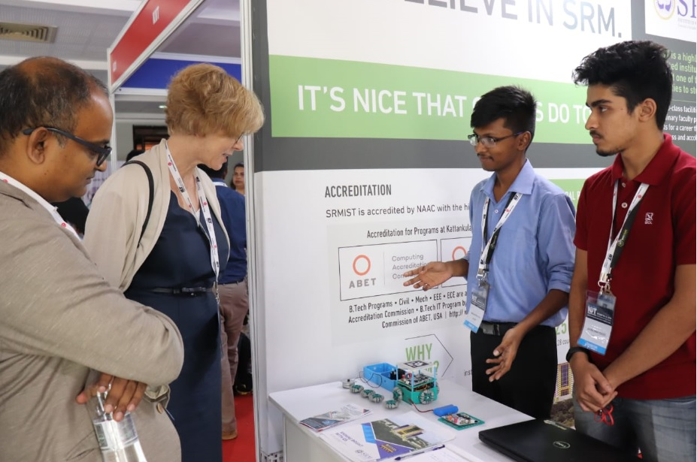
Achievements
RESEARCH:
Sprinter was patented successfully
Publication of the paper ‘Perturbation Analysis in Decentralized Estimators’ in the proceedings of IEEE ROBIO 2018, Kuala Lumpur, Malaysia
Applied for International Conference on Robotics and Automation (ICRA) 2018
Applied for International Conference on Intelligent Robots and Systems (IROS) 2019

Slide 12
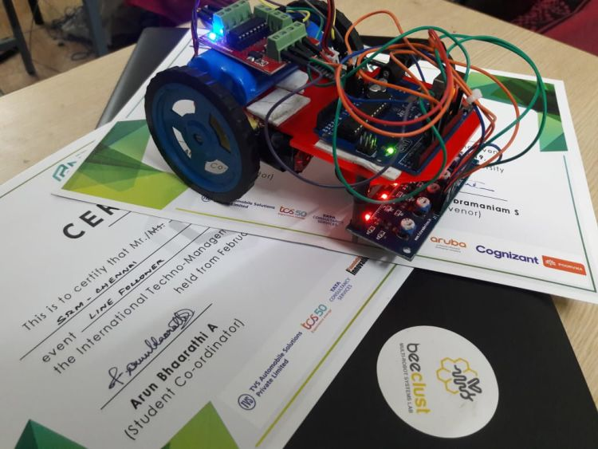
Achievements
COMPETITIONS:
Won the First Place in Line Follower, Daksh-2019
Selected for the Siemens ‘Make it Real Hackathon’ 2017 and 2018
International Finalists at International Autonomous Robotics Competition, IIT Kanpur
WORKSHOPS:
Organized PCB Design, Testing and Fabrication Workshop, 2018
Presented at different workshops such as Machine Learning for Intelligent Speech Processing and Speech Signal & Image Processing

Slide 13
THANK YOU
Contact Us
Venue : Beeclust MRSL, 1306/A, 13th Floor, Tech Park
Sukriti Pandey - 7275956423
Atul John Abraham - 8129674916
Panshul Saraswat - 7013342131

